Slide 1
Q6 Advanced DEMON: Device Monitor based on ONOS
Group 7: The Matrix
2016-04-16
Leader: Cao Rui
Group Member: Chen Yan, Wang Xiang, Gu Rong

Slide 2
Requirements
Question 6:
①
Create an app to count the times of devices up and down. The app should run on every ONOS instance of a cluster, and we could use CLI to check the results on any ONOS instance. When some device gets up and down for X ( X can be configured by CLI) times or more, the app should disable the device automatically.
②
③
④
Notes:
将问题分解为4部分：设备上下线次数，CLI查看次数，阈值，达到阈值后的操作

Slide 3

Analysis
APP
APP
APP
GUI
CLI
Admin service
Service
Distributed Storage
ONOS Cluster
Listener
switch
switch
switch
We Focused on the design of APP module
Device
switch
switch
Notes:
监视底层设备的连接，通过开发Listener注册到Core层实现，监控Device Service
监视结果（获得的设备变化up and down）储存在分布式的Storage里，
超过阀值标记为forbidden auto disable，提供 service 接口，向其他模块提供服务。
阀值可以动态配置，提供Admin service，我们还是需要良好的用户体验，所以GUI CLI

Slide 4
Dig Deeper
APP
★
APP
Admin service
★
Admin service
★
Service
★
Service
CLI
CLI
Storage
Storage
★
Listener
Listener
Sync & persist
AdminService
Service
Service
AdminService
Core
Core
Provider
Service
Provider
Registry
Provider
Service
Provider
Registry
Provider
Provider
Provider
Component
Provider
Component
Protocol
Protocol
Notes:
监视 分布式存储！！！ device/mastership/admin service， 监视、选择、删除设备

Slide 5
Component
Device Monitor acting as artificial intelligence
Service including information provided
Admin service including several configurations
CLI/GUI User interface facing the manager
Set configuration by CLI simply
Show information by GUI/CLI simply
Additional features: dynamic configuration, open to other app module
Additional features GLI provide a friendly user interface in the future
Notes:
具体实现，二个组件，分别是设备监控+Interface。
设备监控分为service（show内容）和admin service（配置内容）；
CLI分为配置和show;
Test case的设计

Slide 6
Monitor Device Connection
Device Monitor
Distributed Storage
Device
Listener
Disable
Device
Device Event Notification
Add Listener
Admin Service
Service
Device Manager

Slide 7
Distributed Storage
Which Distributed Primitives we used?
Strong Consistency
DistributedSet<E>
-----Forbiddenset
AtomicCounter
-----Counter
APP
APP
APP
Device

Slide 8
Connect Handler
event
Device Event
Count++
Local Master?
Already in Forbidden list?
Disable Device！
No
Yes
Yes
No
Connect Event?
≥threshold (X)?
Add in the Forbidden list
No
Yes
Yes
No
END
Notes:
此页胶片需要修改。
1. New added a switch , APP gets informed and count+1
2. Show the count by CLI
3. If the count equals to the X (threshold) , mark the device in the forbidden list and disable
4. Show the threshold value and the forbidden list

Slide 9
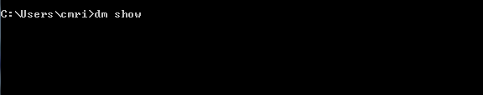
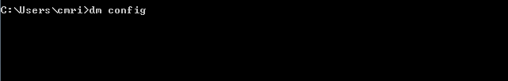

Realization:DEMON
Device Monitor
WHAT WE CAN SHOW?
(1)Switch ID list (2)Connection_count per Switch ID
(3)Threshold (4)Forbidden list
(5)Storage type (6) Forbidden policy (drop/*)
(1)Threshold (2)Storage type (strong/eventually)
(3) Forbidden list (4) policy (drop/*)
(1)Threshold (2)Storage type (strong/eventually)
(3) Forbidden list (4) policy (drop/*)
Notes:
设计模块可以操作的内容

Slide 10
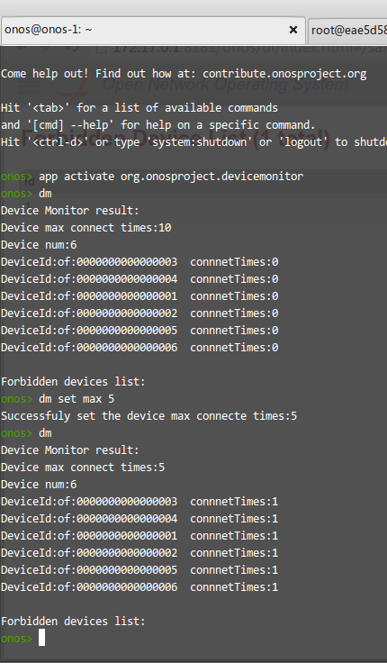
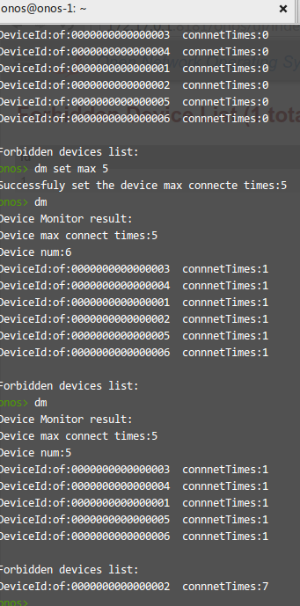
CLI Interface
Show
onos>Dm
onos>Dm forbidden
onos>Dm Max
onos>Dm device [device id]
Configuration
onos>Set max

Slide 11
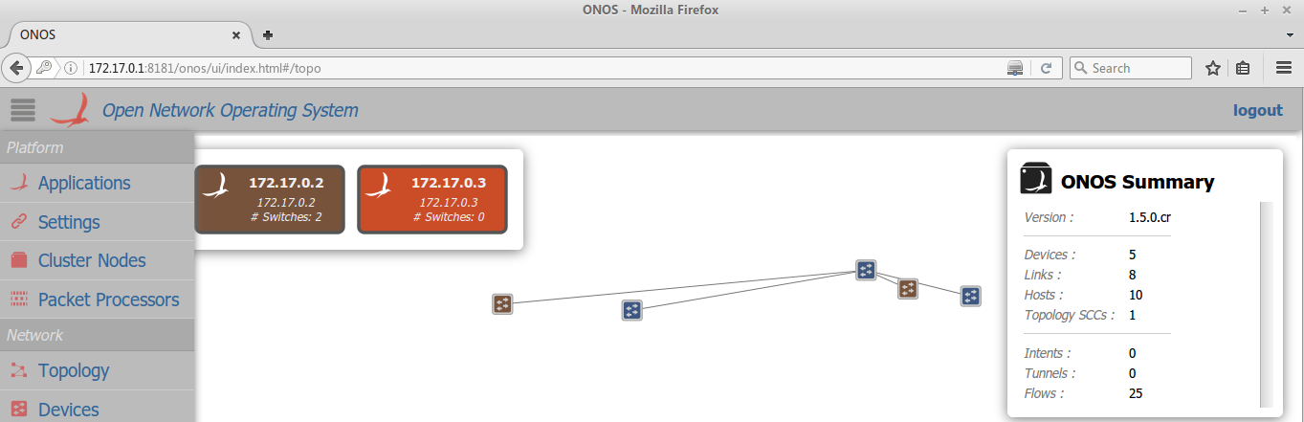
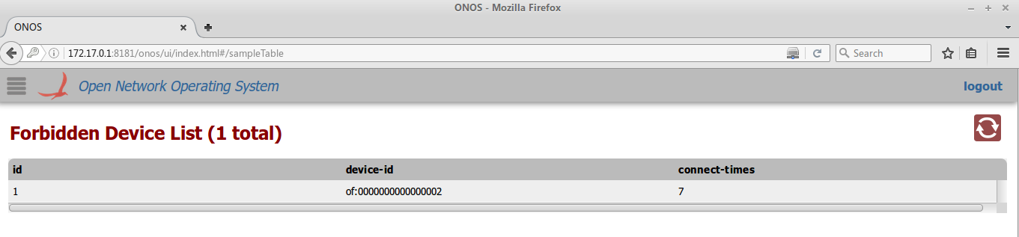
GUI Interface

Slide 12
Demo and test case
Test case1: Show the information of all the devices
Test case2: Show the information of the connection count of the
specific device and check the accuracy
Test case 3: Check the status of the device getting up and down
several times reaching the default threshold
Test case 4: Go through test case 3 after configuring the threshold
Test case 5: Show the forbidden list
Test case 6: Other additional features
Notes:
需要确认：Forbidden list==black list
Demo演示和测试例。

Slide 13
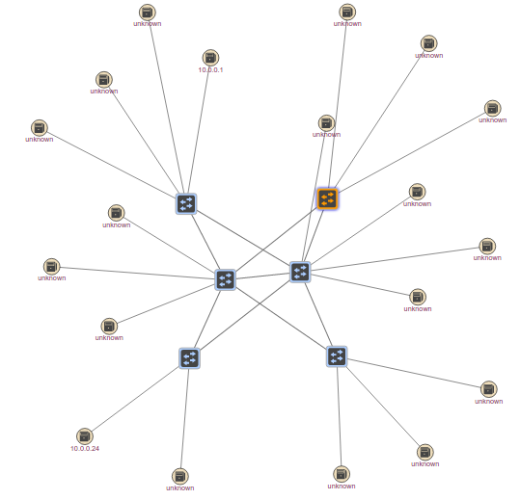
Advantages
Provide HA, scalability and performance
Distributed
Open
Open to 3rd party
Friendly
Provide friendly interface,
CLI/GUI

Slide 14

Future work
Improved GUI
Disable Policy
DEMON
Storage type:
strong/eventually consistency
Black list
White list
Notes:
未来还需要完成的工作
(1)Black list
(2)Whhite list
(3)Disability policy
(4)Storage type: Strong or eventual consistency

Slide 15

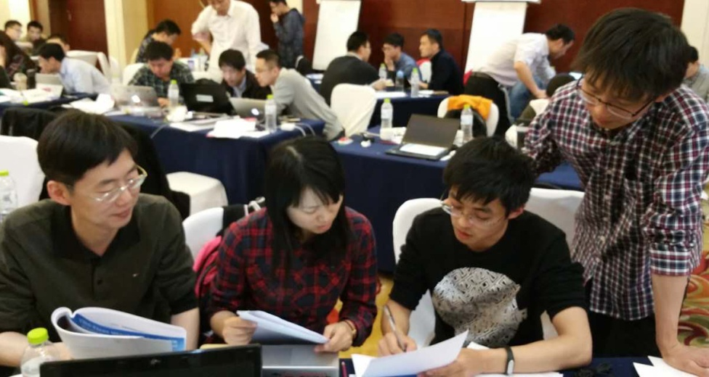
Acknowledge
We have realized the device monitor in ONOS cluster with its basic function.
MANY THANKS TO masters, tutors, and all of you.
Madan, David, Satish, Hongtao, Cas, Henry…
Get an overall knowledge of ONOS
Get familiar with ONOS
Get stuck in ONOS
Be pride with ONOS and DEMON
Grow up with ONOS
Notes:
总结和致谢。

Slide 16

Q&A

